Slide 1
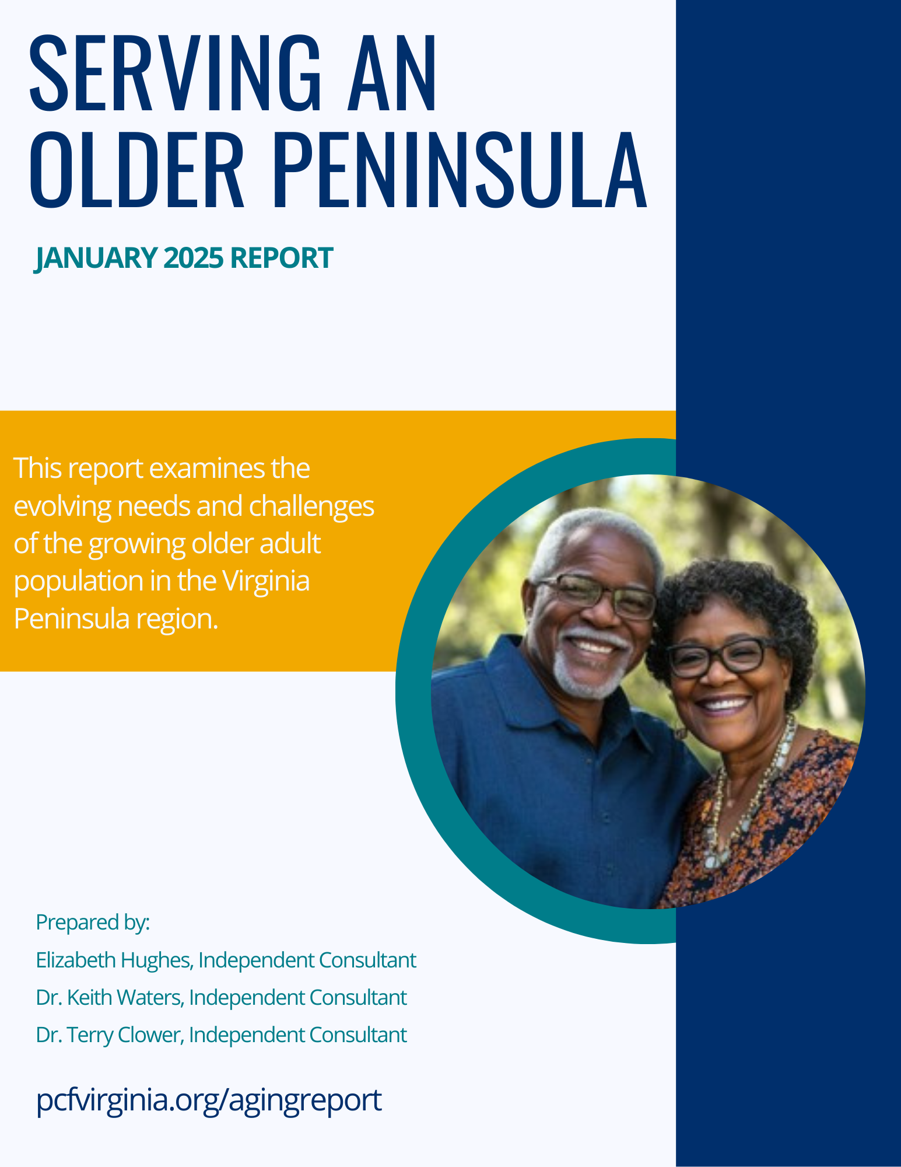

Serving Older Adults in the Peninsula Region
We are deeply grateful for the generous support provided by the Virginia Peninsula municipalities: Hampton, Newport News, Williamsburg, Poquoson, James City County, and York County. This critical funding made the completion of this study and report possible.
We also wish to express our deep appreciation to our partners at the Peninsula Agency on Aging for their invaluable contributions and expertise throughout this project.
November 18, 2024
Notes:
MM

Slide 2
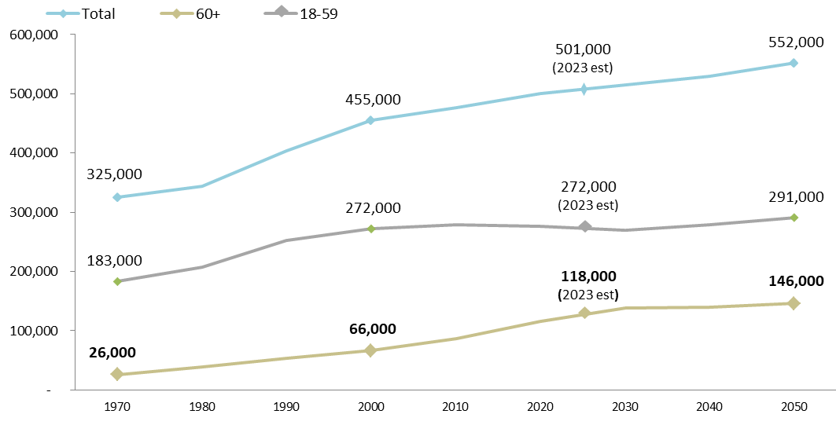
Last 25 years of growth driven by residents age 60+
Since 2000, the population of Peninsula residents age 60+ has nearly doubled in size (gold line) while growth in the working-age population stagnated (grey line). The number of residents age 60+ is expected to grow through 2030 then level off, with the population at 146,000 by 2050.
Fig 1. Number of Peninsula residents, 1970-2050
Source: Serving an Older Peninsula, Fig 1
Notes:
EH

Slide 3
Last 25 years of growth driven by residents age 60+
A Growing and Vibrant Experienced Population
Since 2000, the Peninsula has witnessed a significant increase in its older population, with residents aged 60 and older nearly doubling in number (gold line). This segment of the community has contributed significantly to the region's vitality. While the overall population growth has stabilized, the experienced population will continue to grow steadily through 2030, reaching an estimated 146,000 residents by 2050. This growth presents a unique opportunity for the Peninsula to leverage the valuable contributions of its experienced residents.
Fig 1. Number of Peninsula residents, 1970-2050
Source: Serving an Older Peninsula, Fig 1
Notes:
EH

Slide 4
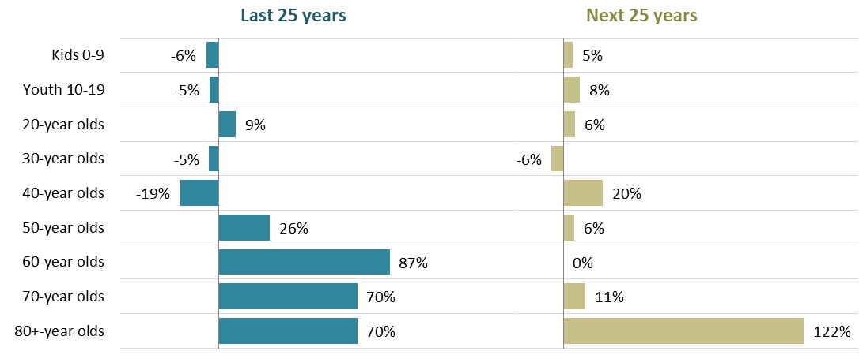
Next 25 years of growth driven by residents age 80+
The region is not just growing older; it is growing substantially older. Over the last 25 years, the fastest growing population was individuals in their 60s (+87%). In the coming 25 years, the fastest growing group in the future will be residents in their 80s (+122%).
Fig 2. Change in number of Peninsula residents by age, 2000-2023 and 2023-2050
Source: Serving an Older Peninsula, Fig 2
Notes:
EH

Slide 5
Next 25 years of growth driven by residents age 80+
Celebrating Longevity: A Growing Population of Experienced Residents
The Peninsula is experiencing a remarkable increase in the number of its long-lived residents. Over the past 25 years, the population of individuals in their 60s has seen significant growth. The next 25 years will witness a remarkable surge in the population of residents in their 80s and beyond. This shift represents a testament to the increasing longevity of Peninsula residents and presents a unique opportunity to create a community that fully supports and celebrates the contributions of its experienced residents.
Fig 2. Change in number of Peninsula residents by age, 2000-2023 and 2023-2050
Source: Serving an Older Peninsula, Fig 2
Notes:
EH

Slide 6
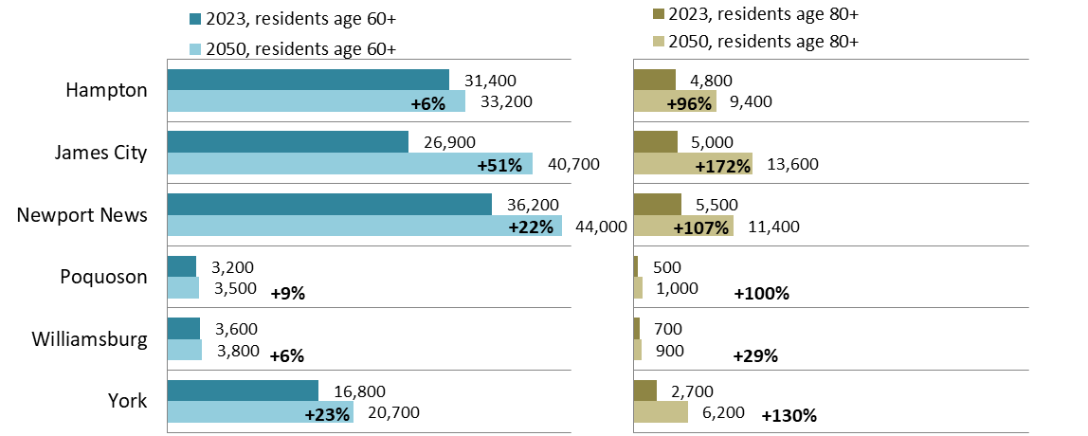
Growth will impact all jurisdictions in the region
Today, about 19,000 Peninsula residents are age 80+ (4% of population); by 2050, an estimated 43,000 residents will be age 80+ (8% of population). Some areas are expected to grow faster than others.
Fig 3. Growth in older adult population in Peninsula Region, by jurisdiction
Source: Serving an Older Peninsula, Fig 3
Notes:
EH

Slide 7
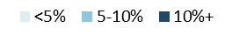
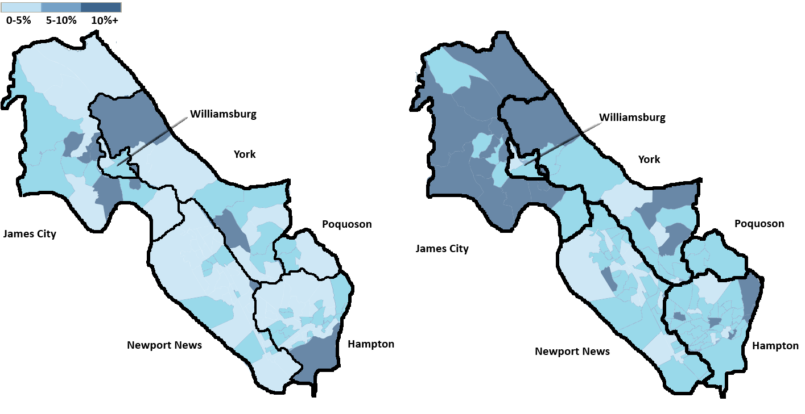
Growth will concentrate in western Peninsula
By 2050, an estimated 20 neighborhoods will have 10 percent or more residents age 80+ (dark blue), and 74 neighborhoods will have 5-10 percent of their population over the age of 80 (medium blue).
Fig 4. Number of neighborhoods (tracts), by percent of residents age 80+, 2024 and 2050
2024 2050
Source: Serving an Older Peninsula, Fig 4
Notes:
EH

Slide 8
Changing Needs within the Community
Notes:
EH

Slide 9
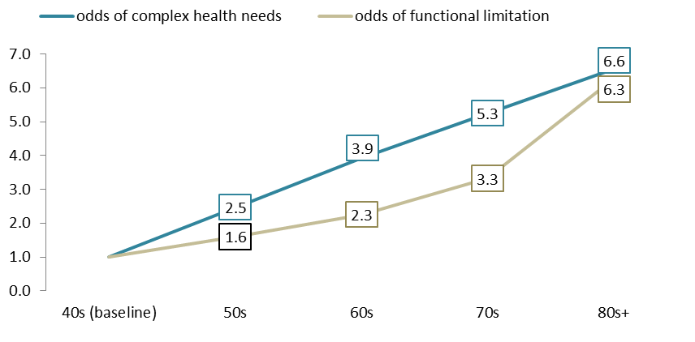
Need #1. Health & Wellness
Complex health conditions and disability tend to increase with age, including in populations who were healthy in younger years. Nationally, someone in their 80s is nearly twice as likely as an individual in their 60s to have complex health needs and 3 times more likely to have a disability.
We project a sizable increase in older residents experiencing a major disability (+16%) and/or with a chronic health condition (+34 percent) by 2034.
Fig 8. Likelihood of complex health needs and functional limitations, compared to those in their 40s
Source: Serving an Older Peninsula, Fig 8
Notes:
EH

Slide 10
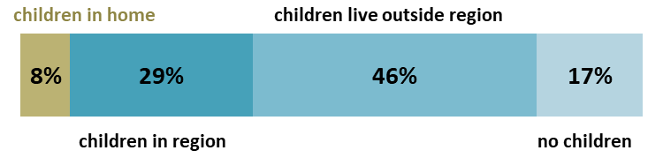
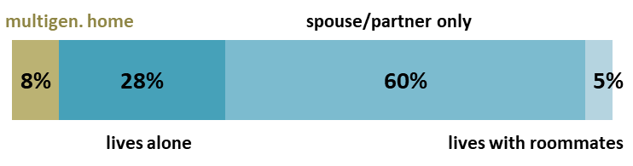
Need #2. Help at Home
As individuals age, their likelihood of having a limitation in daily living that requires physical help (caregiving) increases rapidly; by age 80, 84 percent of individuals have a self-care or mobility limitation, and 42 percent need help from someone else. While family members often provide this help, many older Peninsula residents have limited support networks on which to rely.
We project the number of residents who need formal caregiving help to increase by 16% by 2034.
Fig 13. Percent of older Peninsula residents, by location of adult children and living arrangements
Source: Serving an Older Peninsula, Fig 13
Notes:
EH

Slide 11
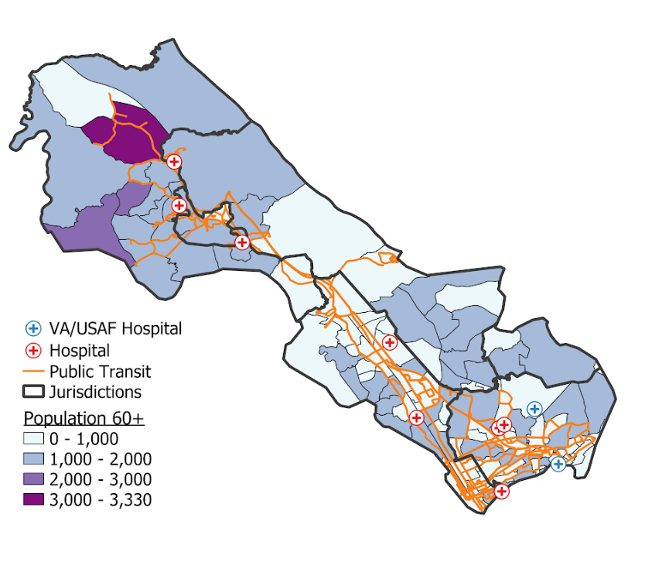
Need #3. Age-Friendly Living
As individuals age, accessibility of home and community becomes increasingly important.
Most older residents live in a single-family home (74%) or townhome/triplex (12%) constructed before 2000 when homes started to be built more for greater accessibly.
Just 2% of older residents live in a truly walkable community, and 62% live in one with below average walkability.
Public transportation service in the region is limited and does not go into many of the neighborhoods where older adults live. Data on ridership in Hampton and Newport News suggest that while 15-18% of riders are age 65-84, virtually none are over the age of 85.
Fig 17. Bus routes in the Peninsula Region
overlaid with concentration of older adults
Source: Serving an Older Peninsula, Fig 17
Notes:
EH

Slide 12
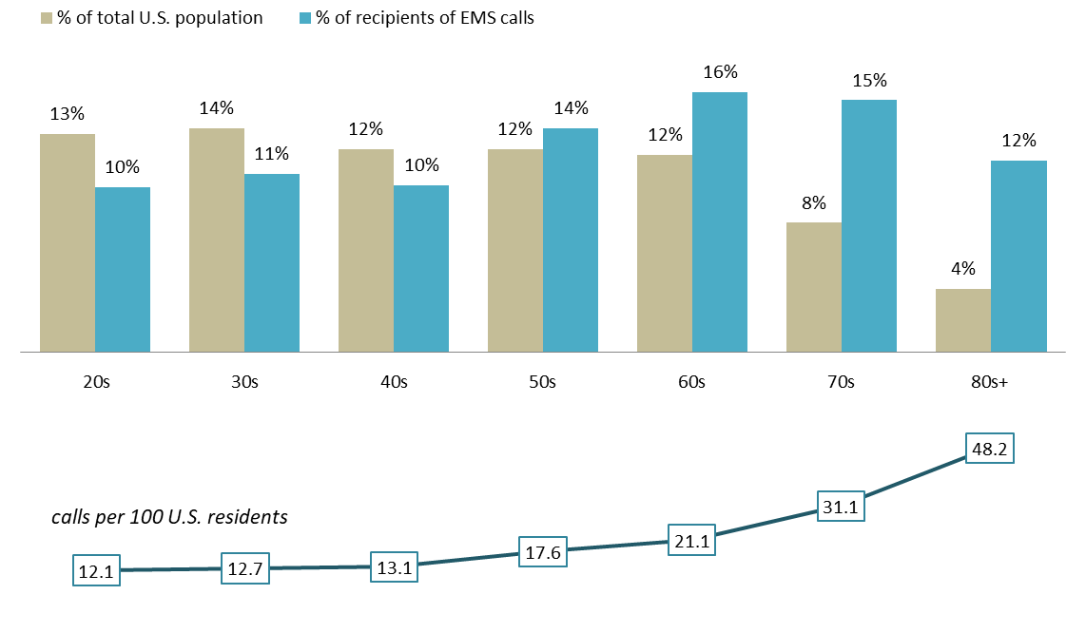
Need #4. Emergency & Safety Assistance
Relative to the size of their population, adults in their 60s place about twice as many calls for EMS service as an individual under age fifty. Adults in their 80s are the largest consumers, about 48 calls for services per 100 individuals. These trends are borne out in local EMS data, too.
We project the number of EMS calls to increase by 12% by 2034.
Fig 18. Percent of U.S. population versus percent of EMS users
Source: Serving an Older Peninsula, Fig 18
Notes:
EH

Slide 13
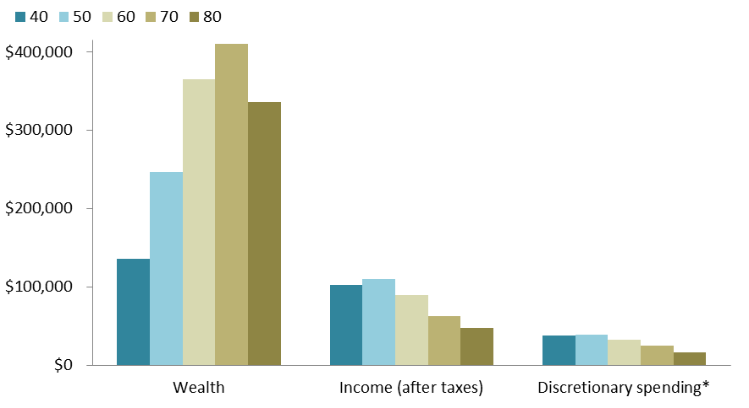
Need #5. Money in Reserve
Wealth and spending habits change as people age. The typical 80-year-old householder in America spends just $17,000 a year on shopping, services, food, transportation, and entertainment, compared to $38,000 spent by the average 40-year old and $33,000 spent by the average 60 year old. Age 80 also marks the point when wealth (net worth) begins to decline, from its peak at age 70.
Fig 24. Household income and net worth by age of householder
Source: Serving an Older Peninsula, Fig 15
Notes:
EH

Slide 14
Projecting Changes to the Local Economy
Notes:
KW

Slide 15
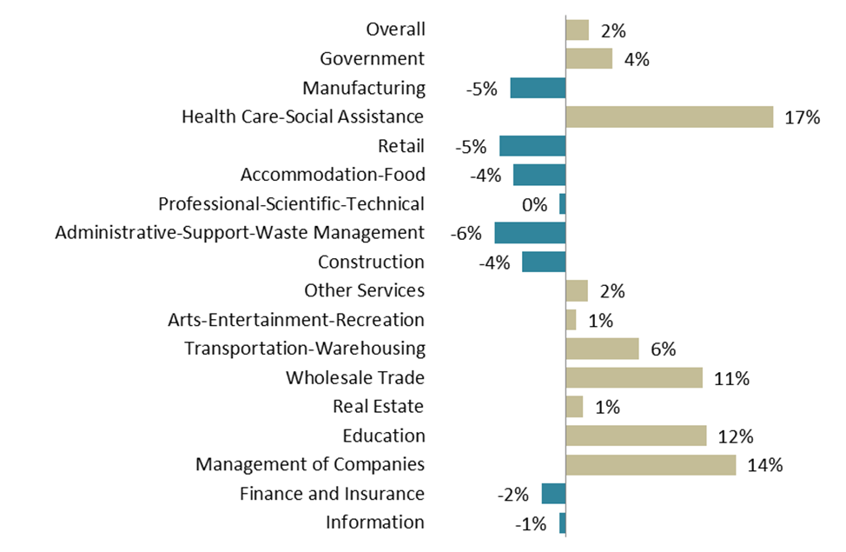
Larger Health Sector
The region’s economy is expected to change as the region’s population requires more frequent and potentially complex medical care.
Fig 11. Projected percent change in employment by industry in Peninsula Region, 2024-2034
Source: Serving an Older Peninsula, Fig 11
Notes:
KW

Slide 16
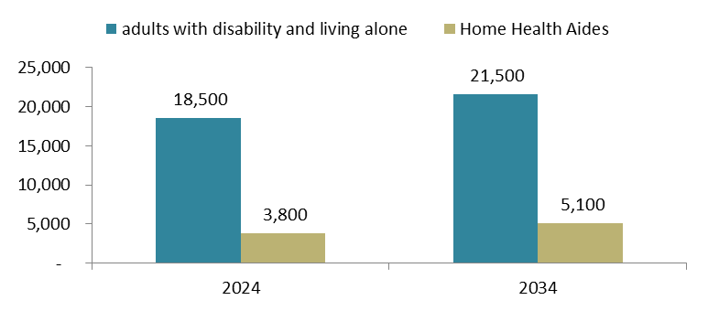
Continued Unmet Demand for Formal Caregivers
An estimated 13,000 older and 5,500 working-age Peninsula residents likely require formal caregiving, a collective need for ~18,500 home health aides (1:1). As of 2024, there were 3,800 aides, about 1 caregiver for every 5 vulnerable residents who needs a caregiver. By 2034, collective need is expected to increase to 21,500 aides, compared to a supply of 5,100 home health aides.
Fig 14. Number of disabled adults living alone for every home health aide, 2024-2034
Source: Serving an Older Peninsula, Fig 14
Notes:
KW

Slide 17
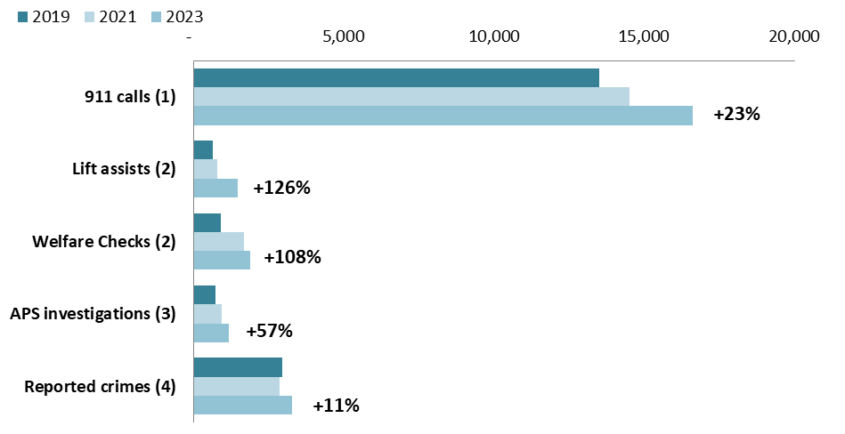
Elevated Use of Local Safety Services
Overall EMS calls are projected to increase by 12% in the next 10 years, while the number of paramedics/ EMTs grows by 2 percent.
Over the last 4 years, local safety agencies have seen an increase in the core services provided to older residents, including lift assists, welfare checks, investigations of elder abuse or self-neglect, and response to crimes against older adults. The largest increase has been in lift assists.
Fig 21. Total service utilization by older Peninsula residents and percent change, 2019-2023
Source: Serving an Older Peninsula, Fig 21
Notes:
KW

Slide 18
Fewer Contributions in Sales Taxes
Changes in spending are expected to impact the Peninsula’s economy as older residents enter their 80s, with median household-level discretionary spending among older adults projected to fall by 6% from 2023 to 2050 and median household net worth declining by 2%.
This change is also expected to impact local governments, which derive 19% of their total revenues from sales and other usage taxes.
Fig 25. Older Adults’ Household Discretionary Spending and Wealth, 2023 to 2050
 | 2023 | 2050 | chg
Median Household Discretionary Spending | $31,000 | $29,000 | -6%
Median Household Net Worth (Wealth) | $475,000 | $467,000 | -2%
Source: Serving an Older Peninsula, Fig 25
Notes:
KW

Slide 19
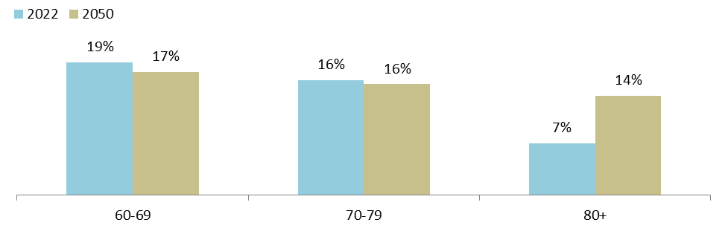
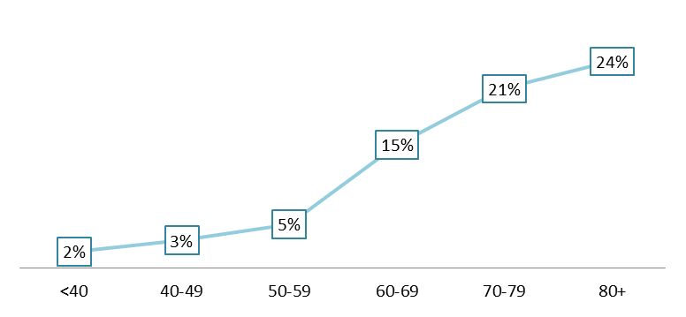
Potential Reduction in Property Taxes
Fig 30. Percent of all property tax paid, by age: 2022 and 2050
Currently, over half of homeowners in the Peninsula region are over the age of 60, and more than a quarter are in their 70s and 80s.
As older adults in the region age in place, the composition of property tax payers is projected to change. This shift toward older taxpayers will begin to impact local revenues—54% of which come from real estate and personal property taxes—if older residents qualify for means-tested tax relief.
Fig 32. Percent of residents where income solely from SS/public assistance
Source: Serving an Older Peninsula, Fig 30,32
Notes:
KW

Slide 20
Questions to inform a regional response
Health & Wellness
What strategies exist to proactively build the healthcare workforce?
To what extent does commercial real estate support a larger healthcare industry?
How can technology be leveraged to improve physical and mental health?
Help at Home
How can regional partners collaborate to identify and serve isolated older residents?
What resources would help support, recognize, and empower family caregivers?
How can the region expand the number of caregivers?
Age-Friendly Living
How can the region improve the accessibility of existing homes at scale?
What approach to future development would promote aging in place?
How can the region think creatively about transportation?
Emergency & Safety Assistance
What models exist to proactively serve frequent EMS-users?
How can the region prepare for a large-scale emergency?
How can regional partners reduce exploitation and crimes against older adults?
Money in Reserve
How can the region offer a more age-friendly shopping experience in the community?
What strategies exist to diversify the region’s tax base?
What services could improve financial stability in the older adult population?
Notes:
TC

